Slide 1

G.H.Raisoni College Of Engineering And Management, Pune
(An Empowered Autonomous Institute, Affiliated to SPPU, Pune,
Affiliated by NAAC A+ Grade)
Department of Electronics and Telecommunication Engineering
AI Driven Agribot
REVIEW -3
Presented by :
Vaibhav Nrupnarayan (A-47)
Harish Bagul (A-24)
Abhiman Bade (A-03)
Guide: Dr. Kavita Joshi

Slide 2
Index
Introduction
Literature Survey
Objectives
Details of the Project
Methodology
Components Used
Project Work Completed
Result Obtained
References

Slide 3

Introduction
Agriculture plays a critical role in the economy, particularly in regions where rice is a staple crop. Traditional rice planting methods are labor-intensive and time-consuming, often leading to inefficiencies and increased costs. To address these challenges, the "Agricultural Rice Plantation Robot using AI & IoT" project aims to develop an innovative solution that automates the rice planting process.
This project leverages Artificial Intelligence (AI) and Internet of Things (IoT) technologies to create a smart, autonomous robotic system capable of performing precise and efficient rice planting. The robot is designed to navigate paddy fields, plant rice seedlings accurately, and monitor environmental conditions in real-time. By integrating AI, the robot can make intelligent decisions to optimize planting patterns and adapt to varying field conditions, ensuring uniform seed distribution, and improving crop yield. IoT sensors will provide continuous data on soil moisture, temperature, and other critical parameters, enabling farmers to make informed decisions about crop management.
The introduction of this robotic system aims to revolutionize rice farming by reducing dependency on manual labor, increasing planting accuracy, and enhancing overall productivity. This project represents a significant step towards modernizing agriculture and ensuring food security through technological innovation.

Slide 4
Literature Survey
Sr.no | Paper Name | Name of Publisher | Publishing Year | Methodology | Result
1 | Smart farming for improving agricultural management | Elsevier | 2021 | Here the cloud based event and data management is done using the cloud system, connecting the different sensors to the cloud and analyse the collected data. | Collection of the data and analyzing it for the future procedure on the crops on the fields according to the quality of the plants.
2 | Application of AI techniques and robotics in agriculture | Elsevier | 2023 | Normal application of AI in detecting the trees, leaves and other factors like detecting the fruits and quality by using image processing and neural network topology, raspberry Pi and the display | Detecting the objects in the fields using AI and deciding the objects.

Slide 5
Sr. no | Paper Name | Name of Publisher | Publishing Year | Methodology | Result
3 | Design and development of the agricultural robot for crop seeding | IJAIEM | 2014 | Here the fully functional agricultural mini robot is made which can drop the seeds automatically into the fields with the help of Arduino, IR sensor, ultrasonic sensor and motors. | The seed of the plant can be sowed without the human requirements with this automated seed planter robot.
4 | Detection of unhealthy region of plant leaves using Image Processing and Genetic Algorithm | IEEE | 2015 | 1. Artificial neural network (ANN) 2. CIELAB color model 3. Color co-occurrence method with SVM classifier | An ANN based classifier classifies different plant diseases and uses the combination of textures, color and features to recognize those diseases. It is used to remove that noise. The training samples can be increased and shape feature and color feature along with the optimal features can be given as input condition of disease identification.

Slide 6
Sr.no | Paper Name | Name of Publisher | Publishing Year | Methodology | Result
5 | Effect for a Paddy Weeding Robot in Wet Rice Culture | Fuji Technology Press | 2018 | 1. Navigation Algorithm (PWM control as the basic navigation control) 2. Capacitive touch sensors 3. Azimuth sensor | The ground is uneven, and the rows of rice seedlings are not always straight, as is the case in terraced paddies. It is used to detect rice seedlings and Measure the movement direction.
6 | Robotics and Automation in Agriculture: Present and Future Applications | ARQII Publication | 2020 | 1. Real-Time Kinematic GPS (RTK-GPS) and IMU 2. Fuji F660EXR Camera 3. Normalized Different Spectral Indices (NDSI) | This new technology is used for position and attitude sensor for navigation system. To monitor the seed falling trajectories which is attached at the Unissem pneumatic planter outlet. It is used in detecting peanut leaf spots.

Slide 7
Objectives
Main Objective:
Specific Goals:
Implement Rice plantation Agribot to Reduce labour costs and manual errors.
Achieve a improvement in rice quality through AI-driven crop quality control measures.
Identify potential issues after specific period from the day plantation to spray the fertilizers before the crucial impact on the crop.
Develop an, Agribot, machinery to sow the rice plant and enhance the quality of rice plantation through crop quality detection.

Slide 8


Methodology
System Design:
Components:
Data Collection and Integration (Sensors, Data Aggregation)
AI and Analytics Engine(Machine Learning Models, Output Dashboard)
Hardware
Software
Data Collection
Data Processing and Storage
AI and Analytics Engine

Slide 9

Begin
Hardware Architecture:
First loading of seedlings
Here is the architecture of the hardware which the rice planter will work and the different actions will be taken by the machine.
Drive mechanism with Motor
Using Slider crank mechanism for Arm
Planting the rice plant
End

Slide 10
Block diagram of the Hardware Circuit.
Sensors
Raspberry Pi
Motor Controller (Controlling the action of robot and planting the seedlings with robotic arm)

Slide 11
Software Architecture:
Input image
Here is the block diagram of the software with which we can detect the quality of the rice plant. The Machine Learning is used to detect the difference between the good quality product and the bad quality product.
Image preprocessing
Image segmentation
Feature extraction
Data base
Training Model
Classification
Display output on the laptop screen

Slide 12
Components Used:
Includes:
- Raspberry pi 4
- chassis and rice planter
- Raspberry Pi Camera Module V2 (8 Megapixel)
- Battery unit
- Stepper Motor (DC 12v)
- Dc Motor (12v)
- Motor controller
- Miscellaneous

Slide 13
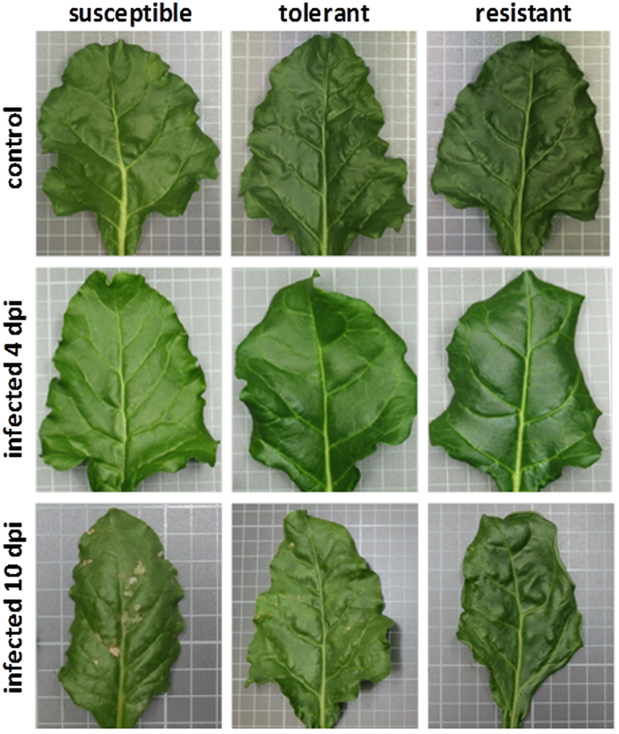
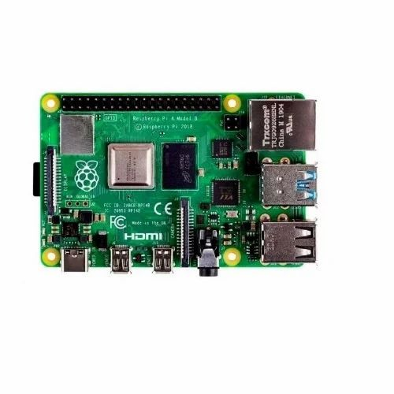
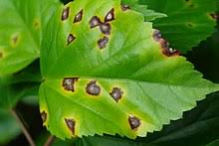
Block Diagram :
Leaves Detection
CV
CV
Uploaded Picture
Annotation
SSD
Mobile Net
Import Real - time frame
Training
Trained
Model
Hybrid Model
Detected Leaves
Predicttion of Plant Health
Classification
Raspberry Pi
CV
CV
Pre-Processing Data Augmentation
Proposed CNN Model
Training
Complete Block Diagram

Slide 14
Project Work Completed Upto Date:
Developing machine learning models for crop quality detection.
Progress made towards identifying crop health issues, but full functionality is still under development.
Used the different Python libraries such as Tensorflow, Keras, OpenCV, Scikit etc to make and train the Machine learning model.
Created the schematic for motors integrated with motor driver and raspberry pi.
Generated the Code for the controlling motors with Motor controller with raspberry Pi.

Slide 15
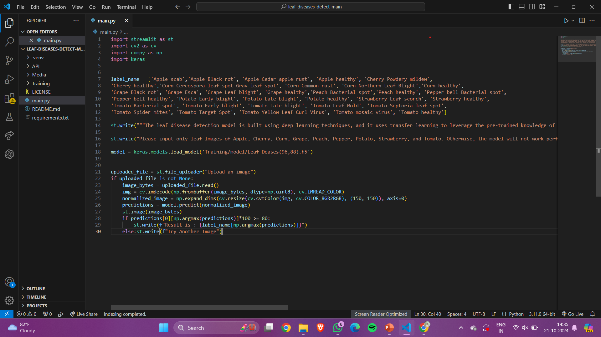
Result obtained :

Slide 16
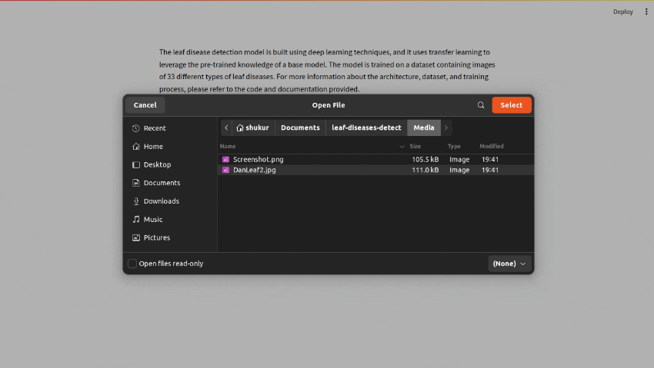
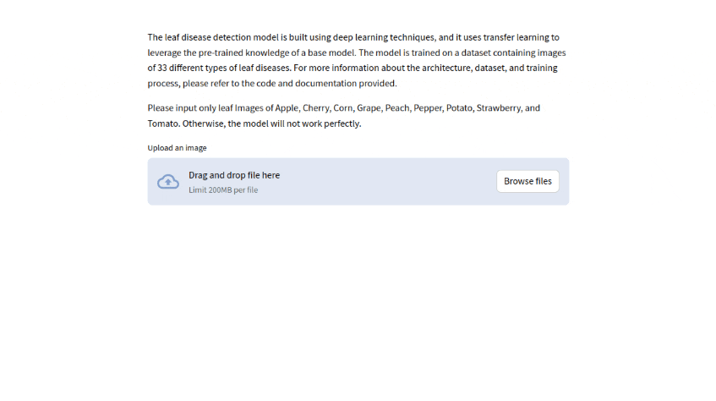
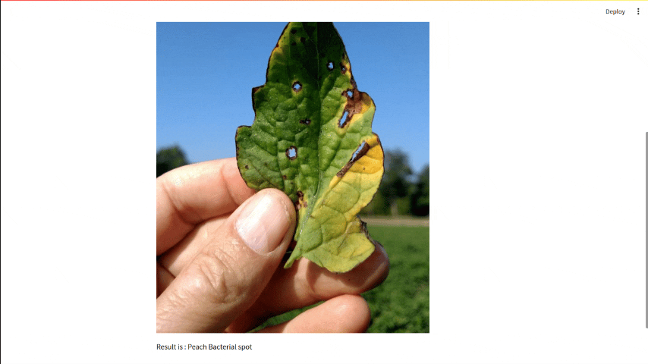
Result obtained :

Slide 17
Conclusion
AI Driven Agribot aims to revolutionize rice farming by integrating AI technology with data monitoring to optimize enhance crop quality, and promote sustainable practices. By addressing the inefficiencies and challenges in traditional rice farming, Agribot seeks to improve yields and achieve high-quality production while ensuring environmental stewardship. The whole Machine learning model is still under development and required important changes.

Slide 18
References
[1] Hitoshi Sori, Hiroyuki Inoue, Hiroyuki Hatta, and Yasuhiro Ando. ‘‘Effect for a Paddy Weeding Robot in Wet Rice Culture’’. Japan. February 27, 2018.
[2] Elsayed Said Mohamed, Sameh Kotb Abd-Elmabod, Mohammed A El-Shirbeny, Mohamed B Zahran. ‘‘Smart farming for improving agricultural management’’. Egypt, 2019.
[3] Prabira Kumar Sethya, Nalini Kanta Barpandaa, Amiya Kumar Rathod, Santi Kumari. “Image Processing Techniques for Diagnosing Rice Plant Disease”. India.
[4] Muhammad Junaid Asif, Tayyab Shahbaz, Dr. Syed Tahir Hussain Rizvi, Sajid Iqbal. “Rice Grain Identification and Quality Analysis using Image Processing based on Principal Component Analysis”, Pakistan, 2018.

Slide 19
References
[5] Pramod Kumar Sahoo, Dilip Kumar Kushwaha, Nrusingh Charan Pradhan, Yash Makwana, Mohit Kumar, Mahendra Jatoliya, Arjun Naik, Indra Mani, “ROBOTICS APPLICATION IN AGRICULTURE”, India,2022.
[7] Mohd Saiful Azimi Mahmud, Mohamad Shukri Zainal Abidin, Abioye Abiodun Emmanuel and Hameedah Sahib Hasan, “Robotics and Automation in Agriculture: Present and Future Applications”,Malaysia, April 2020.
[8] Vijai Singh Asst Professor, Varsha Asst Professsor, Prof. A K Misra, “Detection of unhealthy region of plant leaves using Image Processing and Genetic Algorithm”, India, 2015.
[9] K. Tamaki, Y. Nagasaka, K. Nishiwaki, M. Saito, Y. Kikuchi, K. Motobayashi, “A Robot System for Paddy Field Farming in Japan”, Japan, 2013.

Slide 20
Thank You

